Slide 1
Famous Kings of India
1
Chandragupta Maurya 321bce–. 297 bce
2
Ashoka 265–238
3
PrithviRaj Chauhan 1178–1192
4
Maharana Pratap 1 March 1572 – 19 January 1597

Slide 2
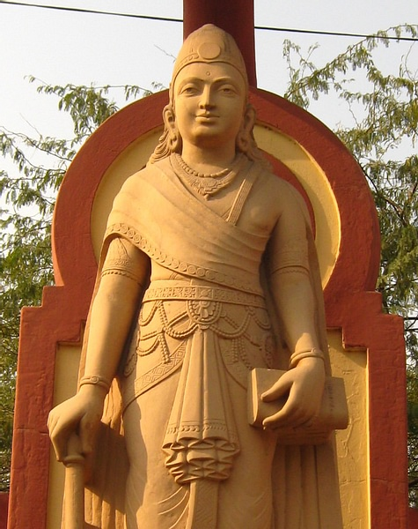
ChandraGupta maurya
Chandragupta Maurya was born in Patna in 340 BCE. His father was Prince Sarvarthasiddhi of the Nanda Kingdom. He was a humble person.
Chandragupta was the founder of the Mauryan dynasty (reigned 321 bce –. 297 BCE) and the first emperor to unify most of India under one administration. He is credited with saving the country from maladministration and freeing it from foreign domination. He abandoned his throne and converted to Jainism, eventually becoming a Muni. he meditated and fasted to death in 298 BC. He was succeeded by his son, Bindusara, who was later succeeded by his grandson, Ashoka who became one of the most influential rulers of India.

Slide 3

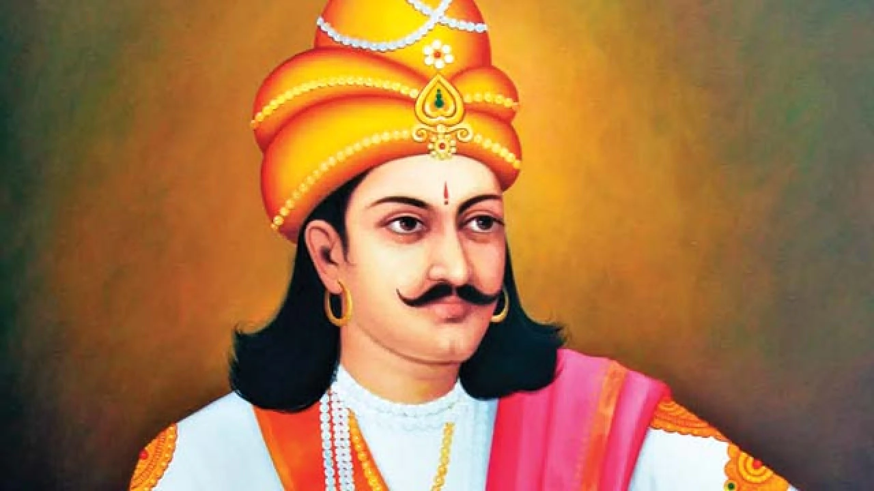
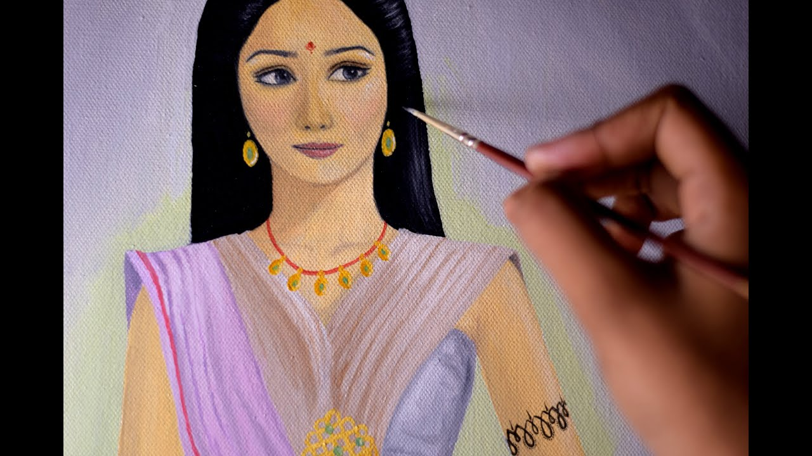
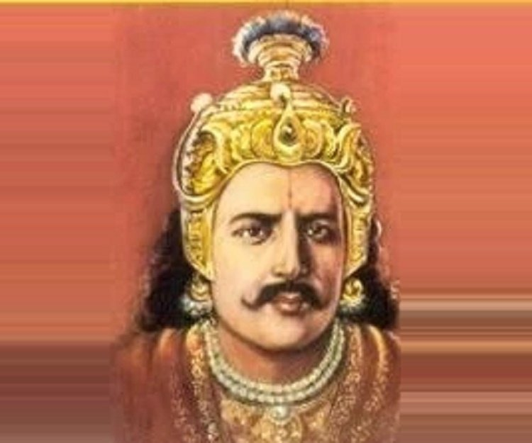
Ashoka
The last major emperor in the mauryan dynesty of india .
Was the son of and Ashoka Ruled from 265–238 bce
The wheel which adorns the flag of india, has kept his memory green. Lord of vast empire. after a great victory on the battlefieild. ASHOKA grew sick of violence and took an oath to never fight again…
BINDUSARA
SUBHADRANGI

Slide 4
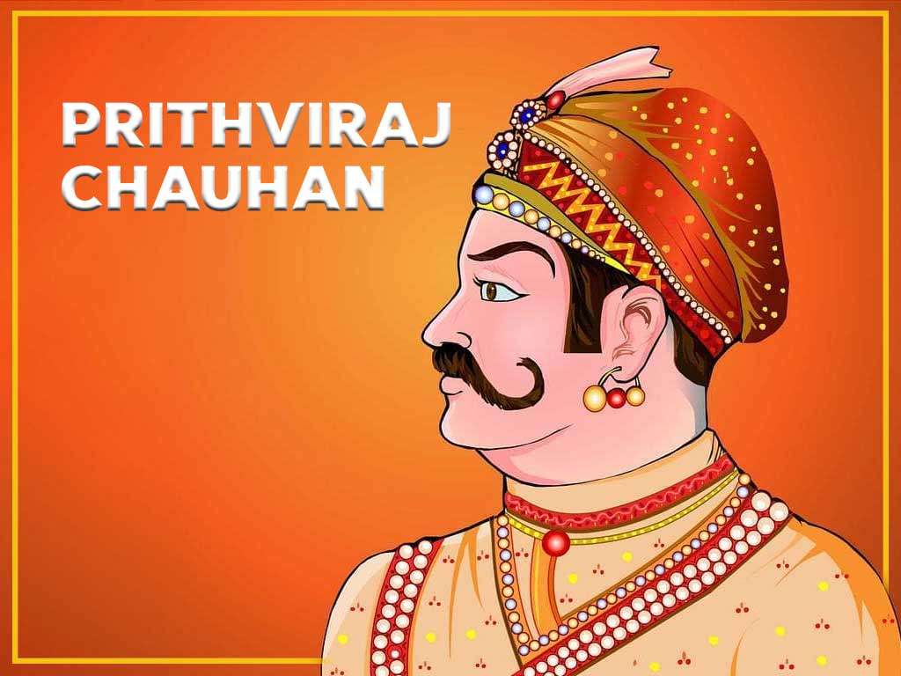
Prithviraj chauhan

